Slide 1
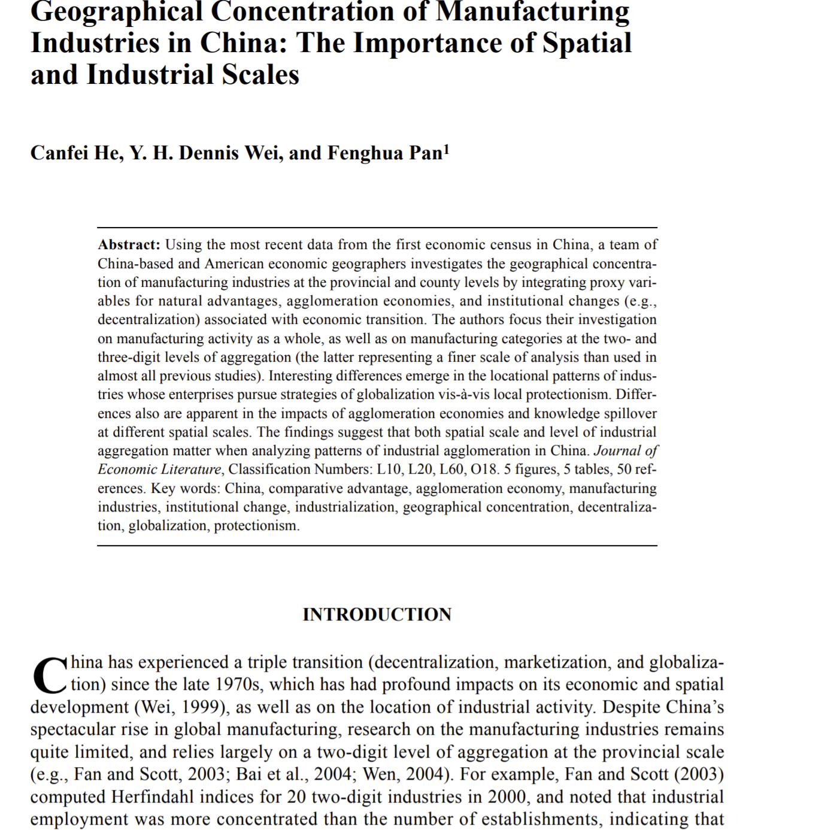
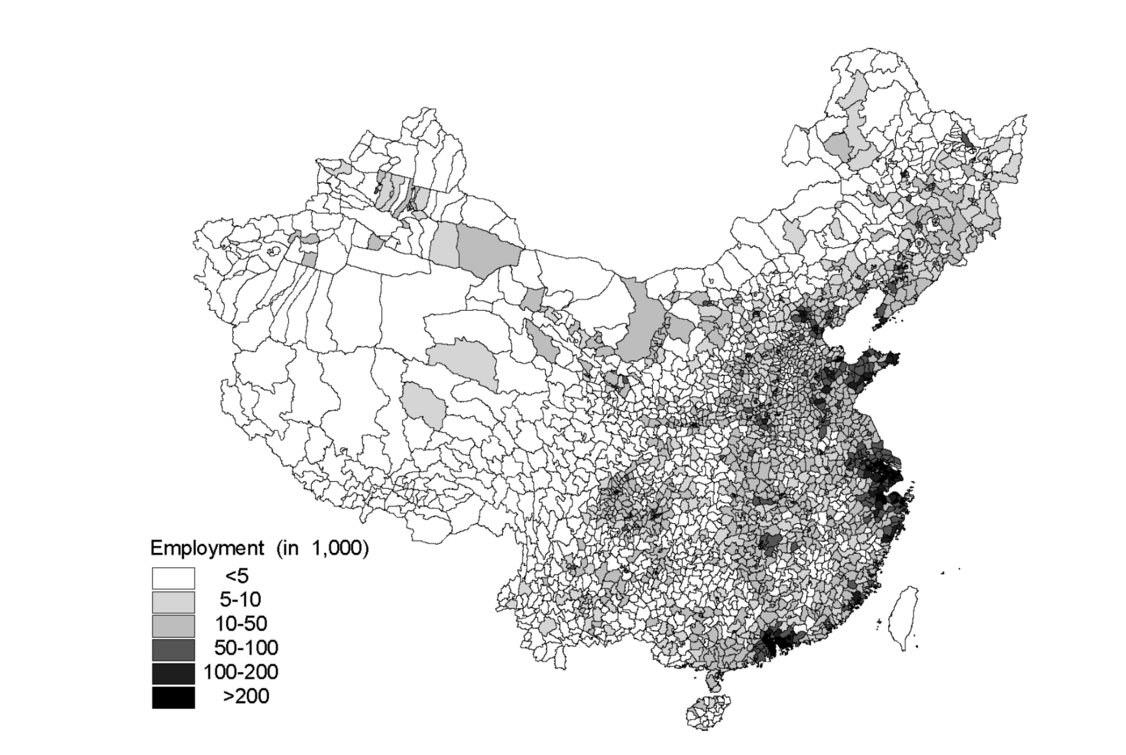
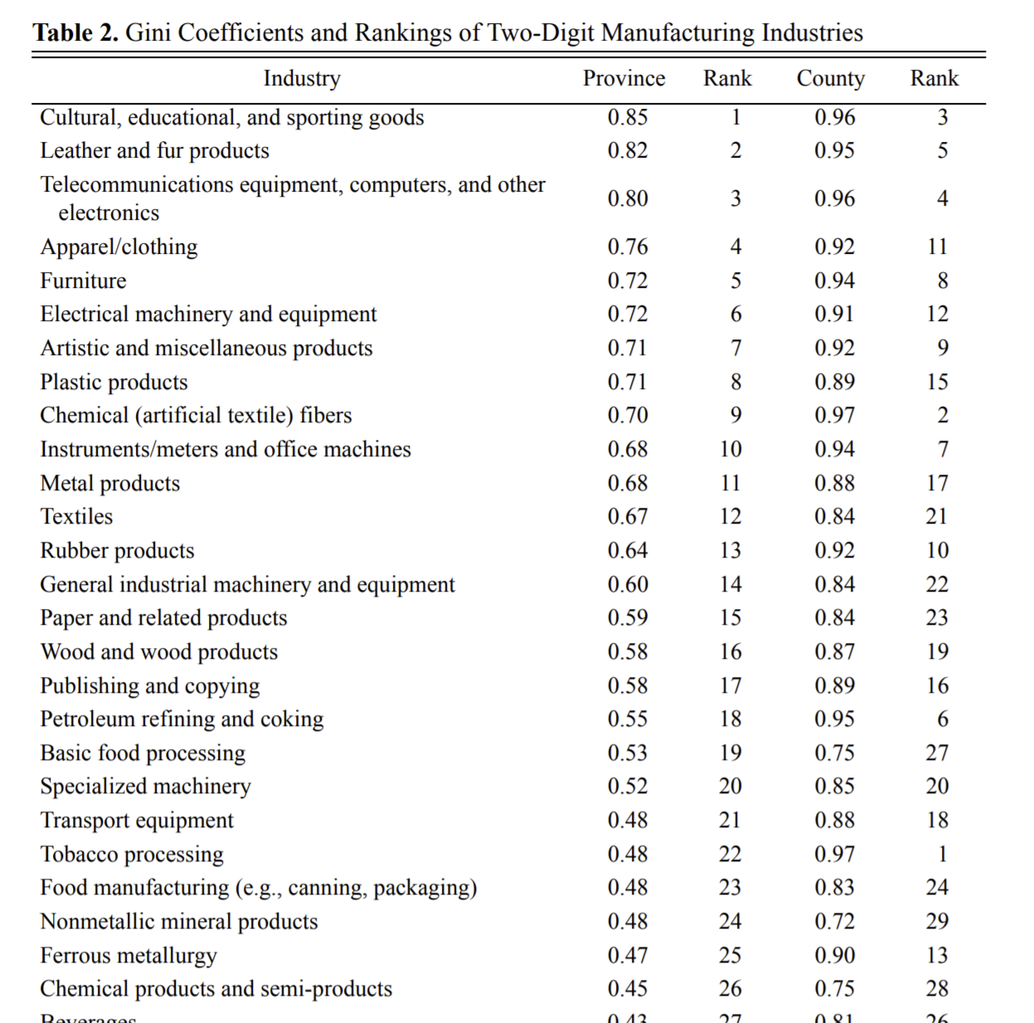
Case Study Four: Geographical Concentration of Manufacturing Industries
Canfei He , Y. H. Dennis Wei & Fenghua Pan (2007) Geographical Concentration of Manufacturing
Industries in China: The Importance of Spatial and Industrial Scales, Eurasian Geography and Economics, 48:5, 603-625
Objectives: To evaluate spatial distribution of different industries of China at disaggregated levels using data from the 2004 economic census of China.
Data Sources
China Data Online
Data
2004 Main Industry Performance (2014) (China Data Online)
City Employment Data (China Data Online)
Employment Numbers (Province) (China Data Online)

Slide 2
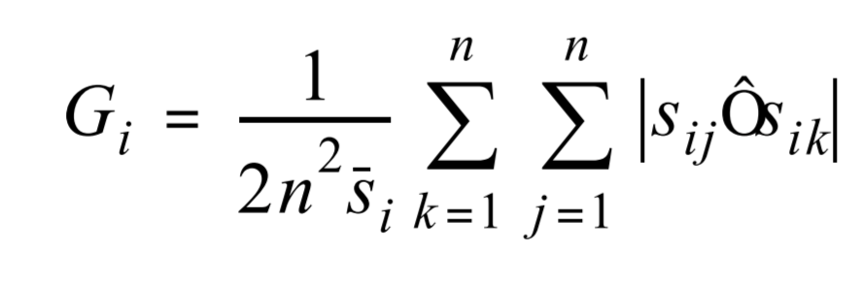
Case Study Four: Geographical Concentration of Manufacturing Industries
Methodology
The author refers to Wen’s “Relocation and Agglomeration of Chinese Industry” (2004) paper and uses industry-based Gini coefficient from the paper. And then the author applies the coefficient calculation for selected industries of China. The author evaluates and compares Gini's coefficient for both province and city level industry performance.
Flowchart
Data Inputs
Performance of Industries by Region (2004)
Data Analysis
Outputs
Spatial Analysis
Map Based Plot
Employment Distribution Data (2004)
Industrial Gini-Coefficient Calculation
Bar Charts
Province Level Shapefile
Tables

Slide 3
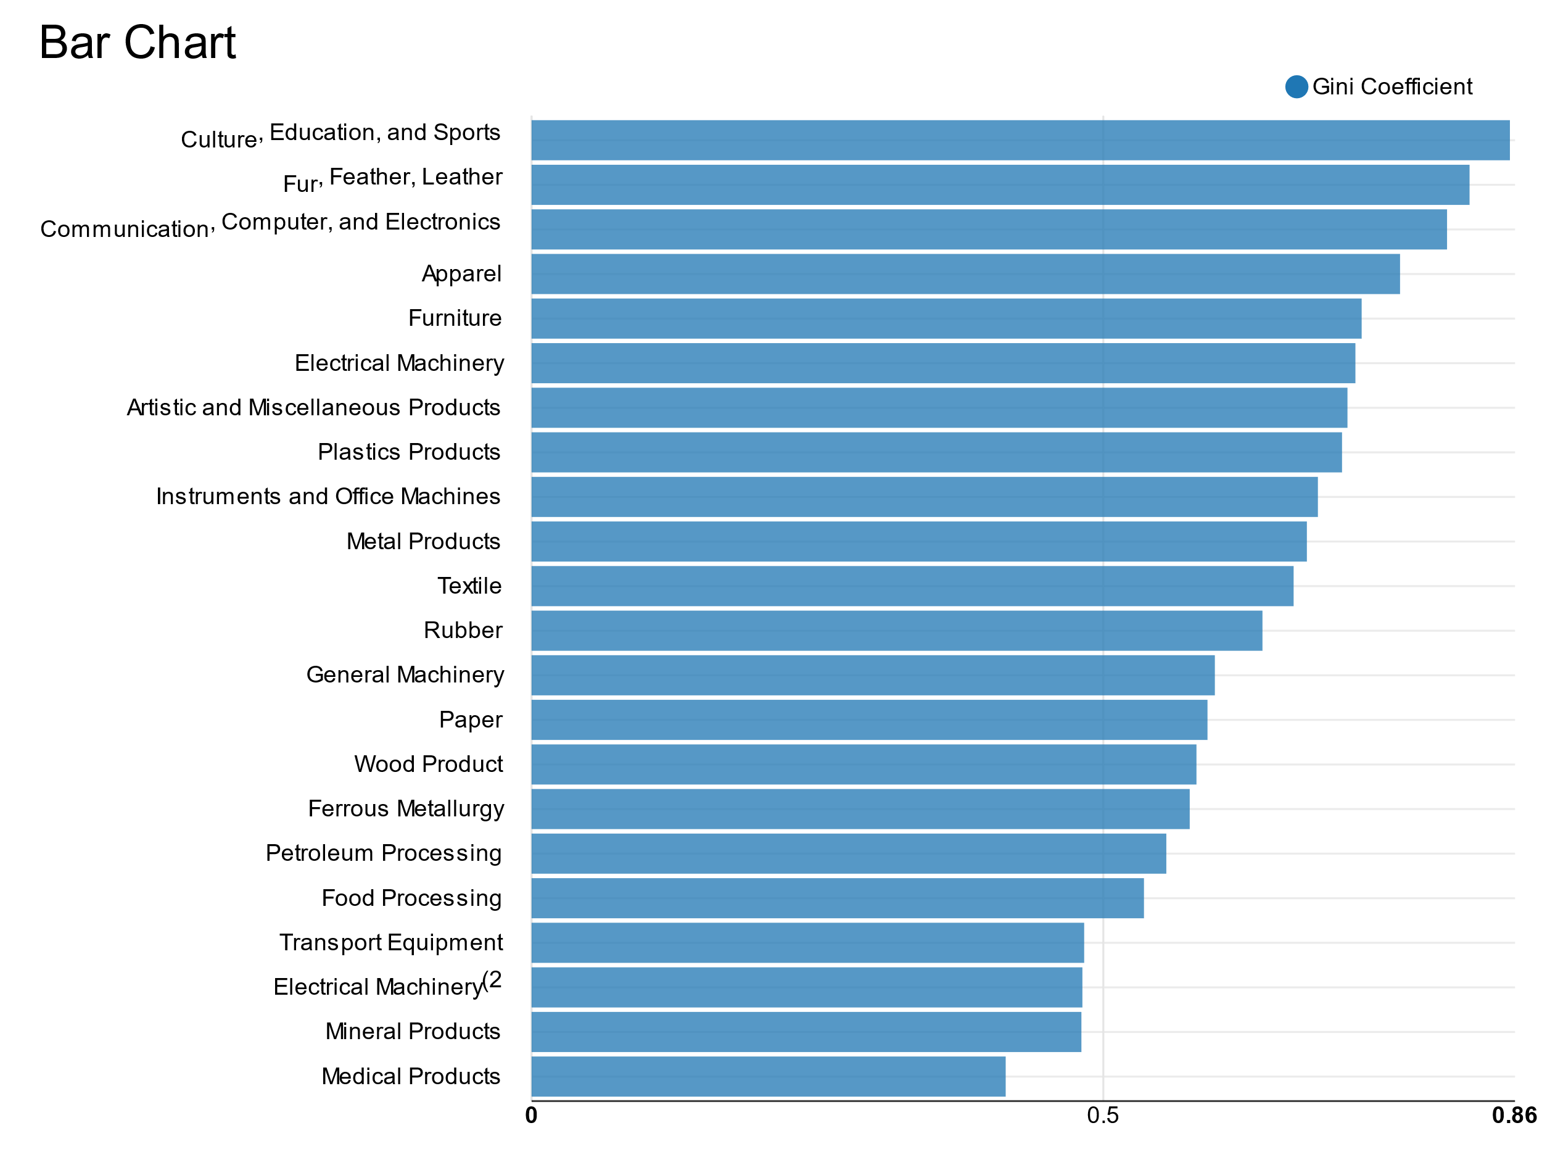
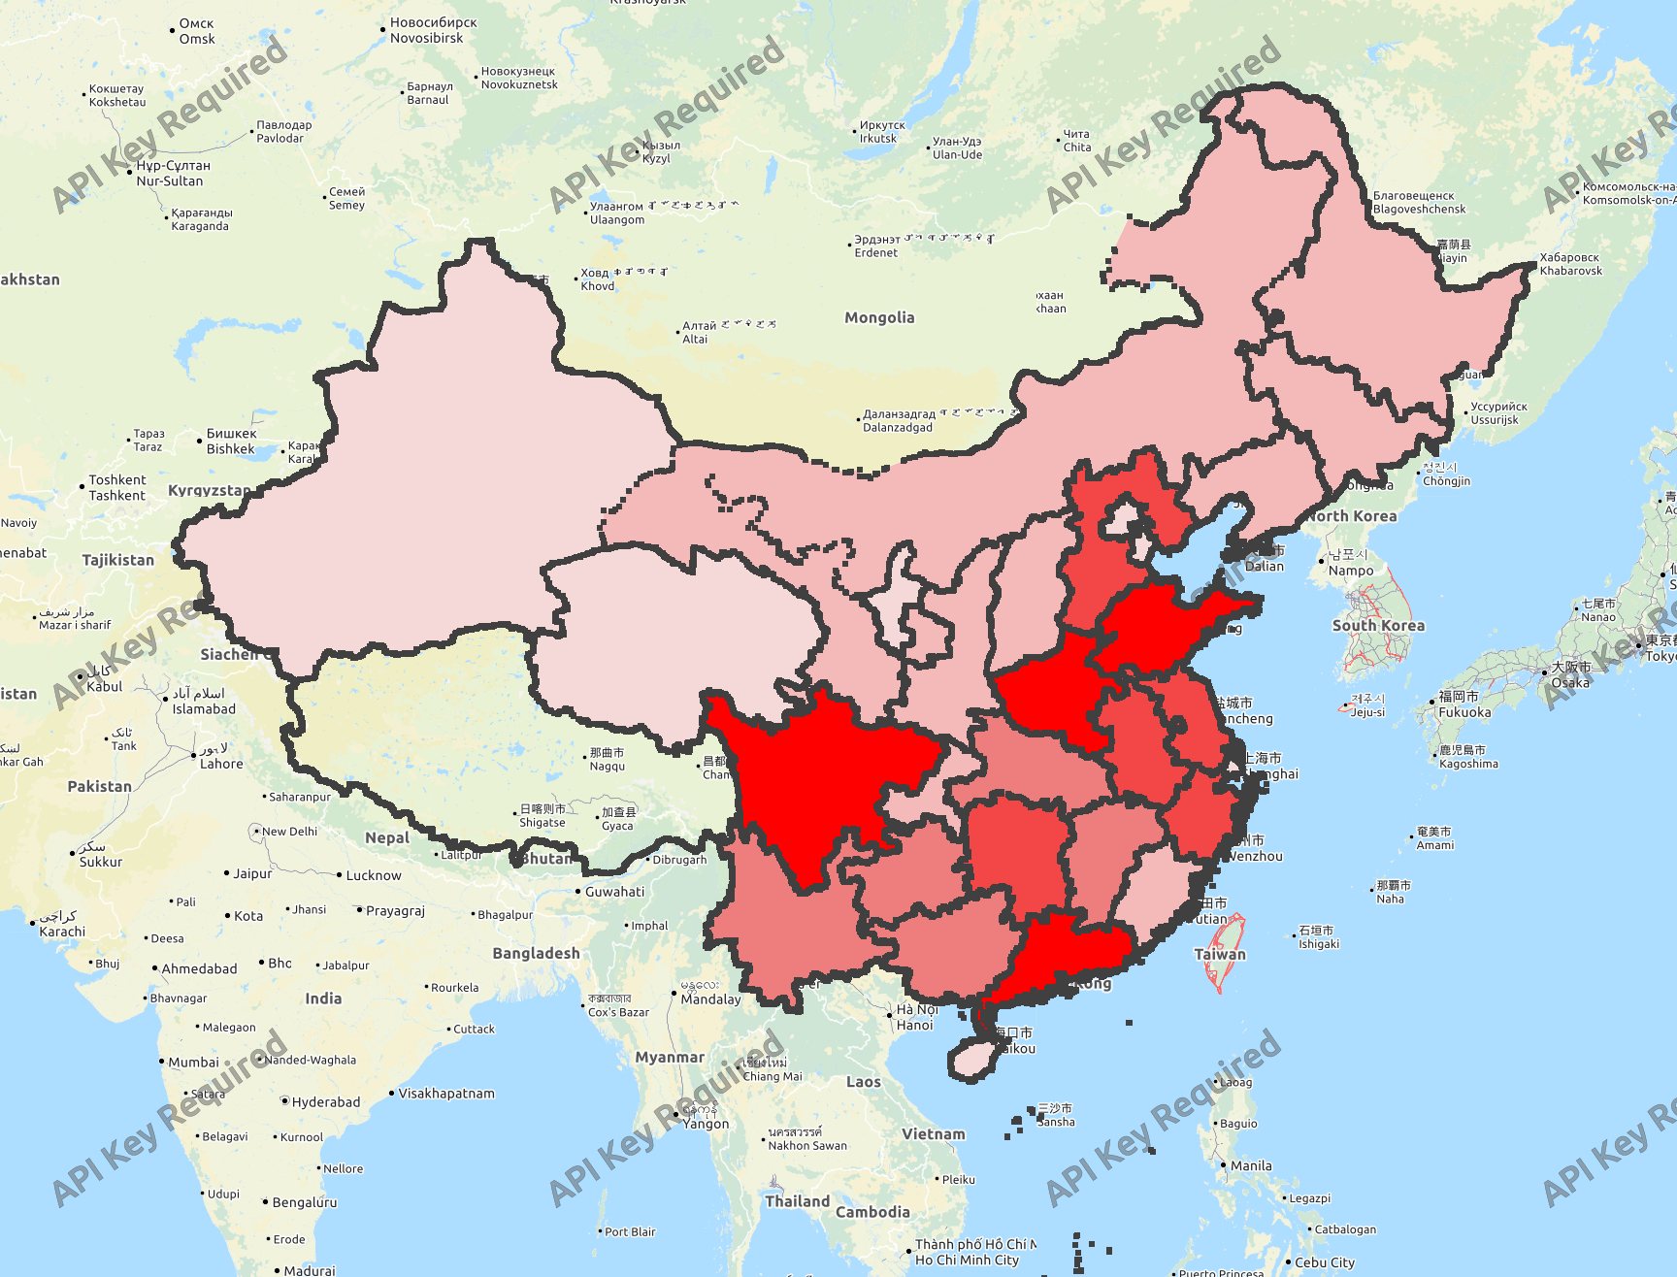
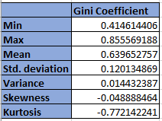
Case Study Four: Geographical Concentration of Manufacturing Industries
Outputs from the Workflow
Gini Distribution of Second-Level Industries in China
Spatial Distribution of Second Digit Industries in Chinese Provinces
Industrial Gini Coefficient By Employment

Slide 4
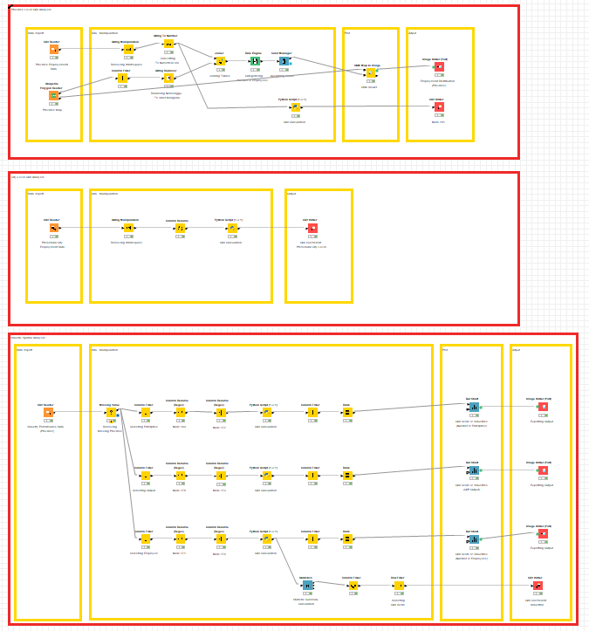
Case Study Four: Geographical Concentration of Manufacturing Industries
Spatial Distribution
Analysis (Province)
Spatial Distribution
Analysis (City-Level)
Industrial Gini
Coefficient Calculation
By Employment, GDP, and
Enterprise Distribution
(Province-Level)

Slide 5
Case Study Four: Geographical Concentration of Manufacturing Industries
Steps for Running the Workflow
Step 1: Download data and unzip from \03_Geographical_Concentration_of_Manufacutring_Industries_in_China\01_data\
Step 2: Download workflow from \03_Geographical_Concentration_of_Manufacutring_Industries_in_China\02_workflow\
Step 3: Open KNIME from local PC or China Data Lab Cloud Platform (in building)
Step 4: Import KNIME workflow file (Geographical Concentration of Manufacutring Industries in China.knwf)
Step 5: Configure all nodes in “data collection”
Step 6: Configure all nodes in “exporting output”
Step 6: Click Run function from the top menu
Step 7: Display the outputs:
Employment Distribution (Province)
Gini Calculation of Province Employment Distribution
Gini Calculation of City Employment Distribution
Gini Score of Industries (Number of Enterprise)
Gini Score of Industries (Employment)
Gini Score of Industries (GDP Output)
Industrial Gini Coefficient Statistical Summary Table

Slide 6
Case Study Four: Geographical Concentration of Manufacturing Industries
Summary
The workflow replicates the paper’s main parts and visualize the results in forms of tables, charts, and a map.
As expected, industries are much more concentrated at the city level, which has higher Gini coefficients, suggesting that industrial agglomeration may extend beyond city boundaries. The most diversely distributed industries were “culture, education, and sport goods”, “ fur, feather, and leather” industries. The most concentrated industries were medical, mineral, electronic machinery, and transport equipment.
Industries tend to be more aggregated at more disaggregated industrial scales and finer spatial units.
Limitation
The data that this KNIME workflow uses differ from the research paper. The paper does not specify which industrial performance metric they used to calculate some Gini coefficients. Additionally, some data like third-level industrial performance data and county-level employment distribution data were not accessible. Due to the differences of the data, the outputs of the workflow slightly differ from that of the paper.

Slide 7
References
Canfei He , Y. H. Dennis Wei & Fenghua Pan (2007) Geographical Concentration of Manufacturing Industries in China: The Importance of Spatial and Industrial Scales, Eurasian Geography and Economics, 48:5, 603-625
China Data Online https://www.china-data-online.com/

